Slide 1







Top IT Industry Trends
Leo Angelo Bacolores
May 4, 2022

Slide 2



OUTLINE
Executive Summary
Introduction
Methodology
Results
Visualization – Charts
Dashboard
Discussion
Findings & Implications
Conclusion
Appendix

Slide 3

EXECUTIVE SUMMARY
JavaScript is the most popular programming language to work with
Linux continuous to be the top most popular platform
Followed by Windows and Docker
BASH as the most desired language next year
Visual Studio Code reigns the Development Environment
jQuery is the best pick of the people for Web Frameworks

Slide 4

INTRODUCTION
IT industry continues to innovate and develop in the fast-paced manner
New languages, databases and platforms are desired in the future
This study explores the information gathered from the Stack Overflow archived dataset
It elaborates the sentiments of software developers around the world regarding what technologies they prefer to use
Programming Languages
Database and Platforms
Web Frameworks

Slide 5

METHODOLOGY
The survey is conducted globally and received 88,883 responses from 179 countries
The survey took place in 2019 from January to February
Respondents were mainly from channels owned by Stack Overflow
Channels such as:
On-site messaging and Emails
Blog posts and Meta posts
Banner ads

Slide 6
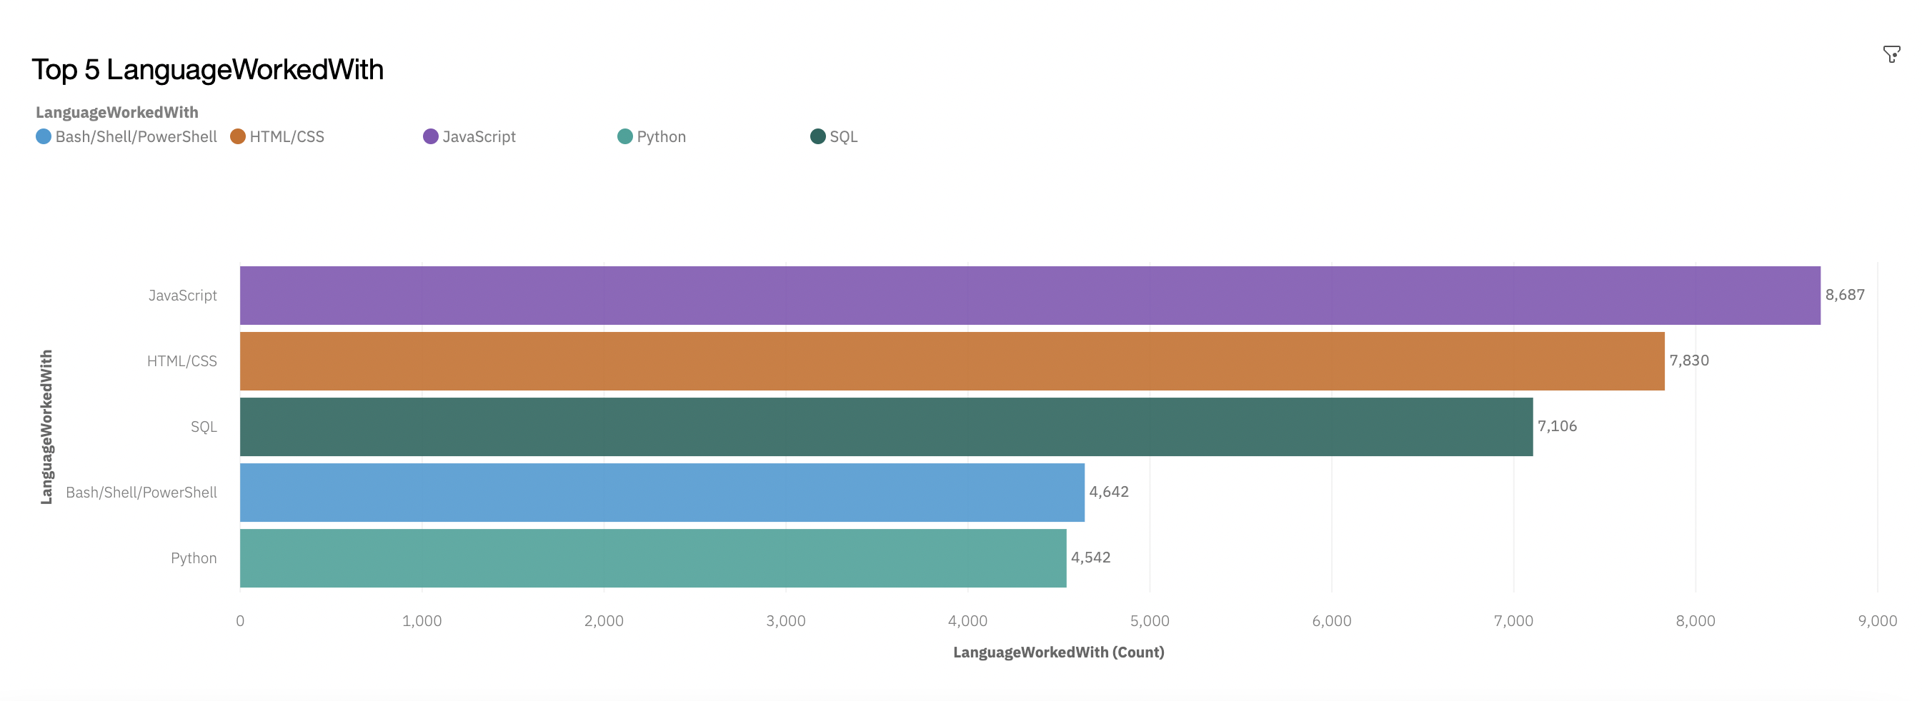
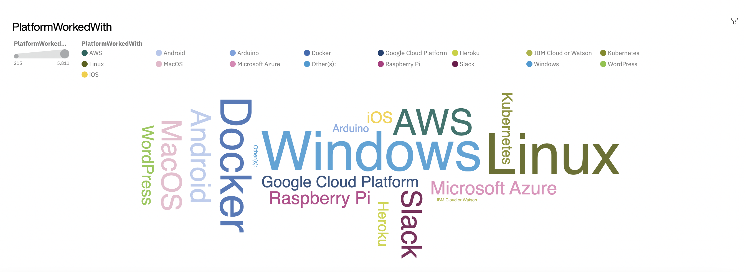
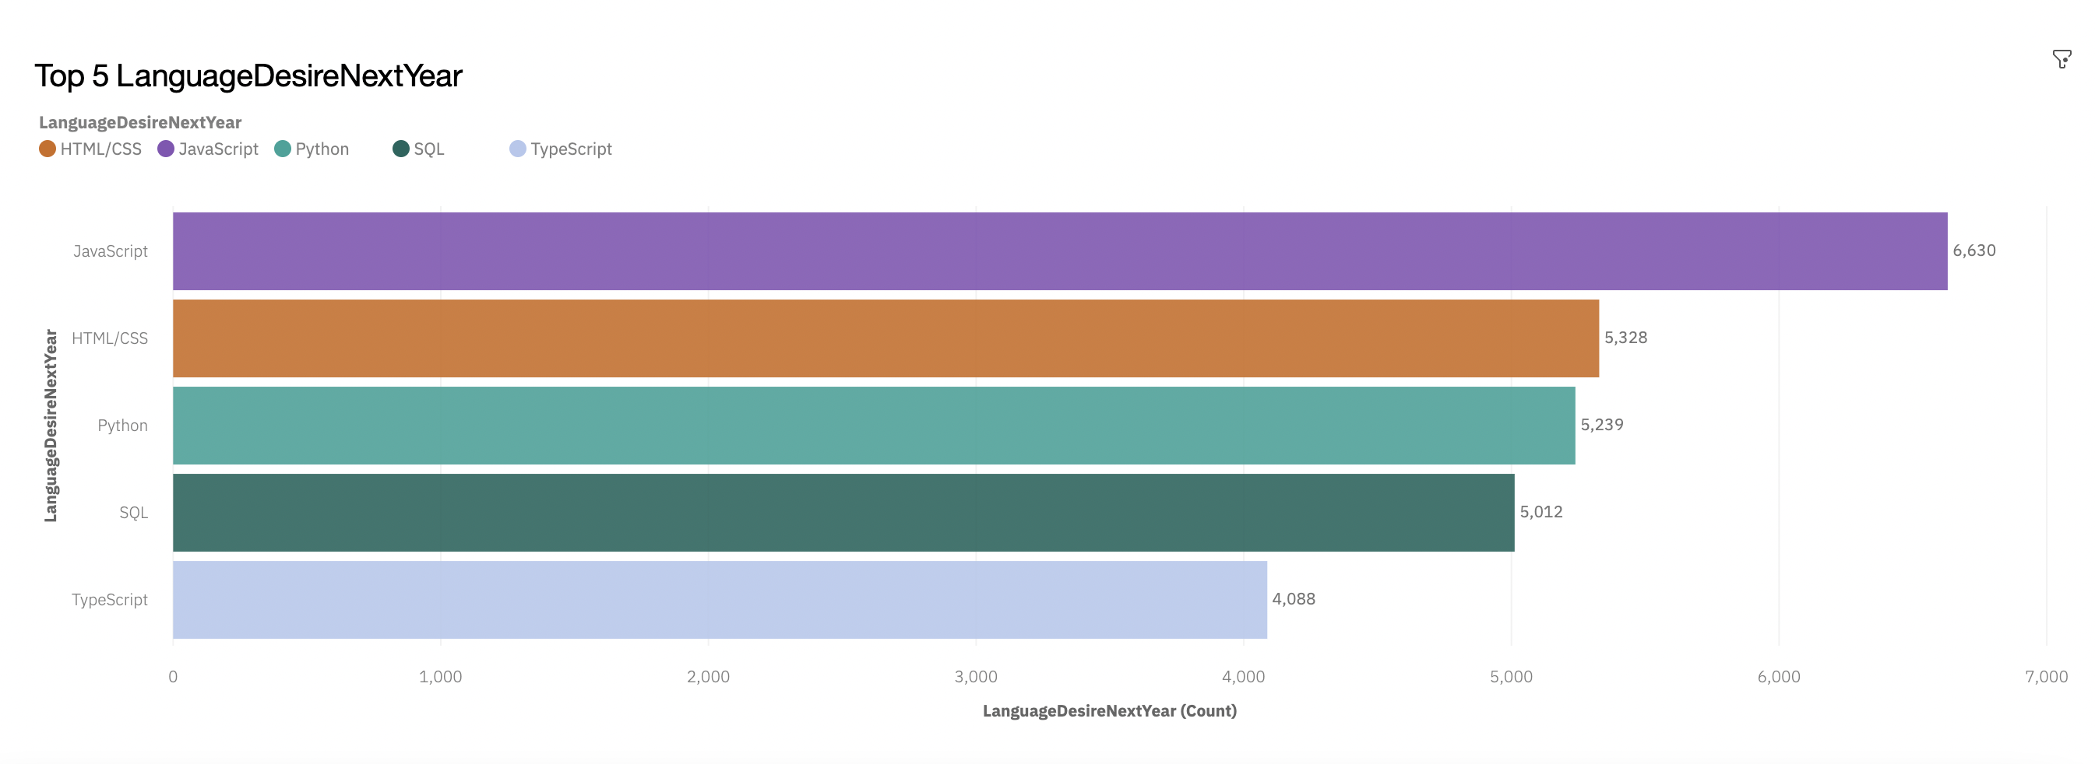
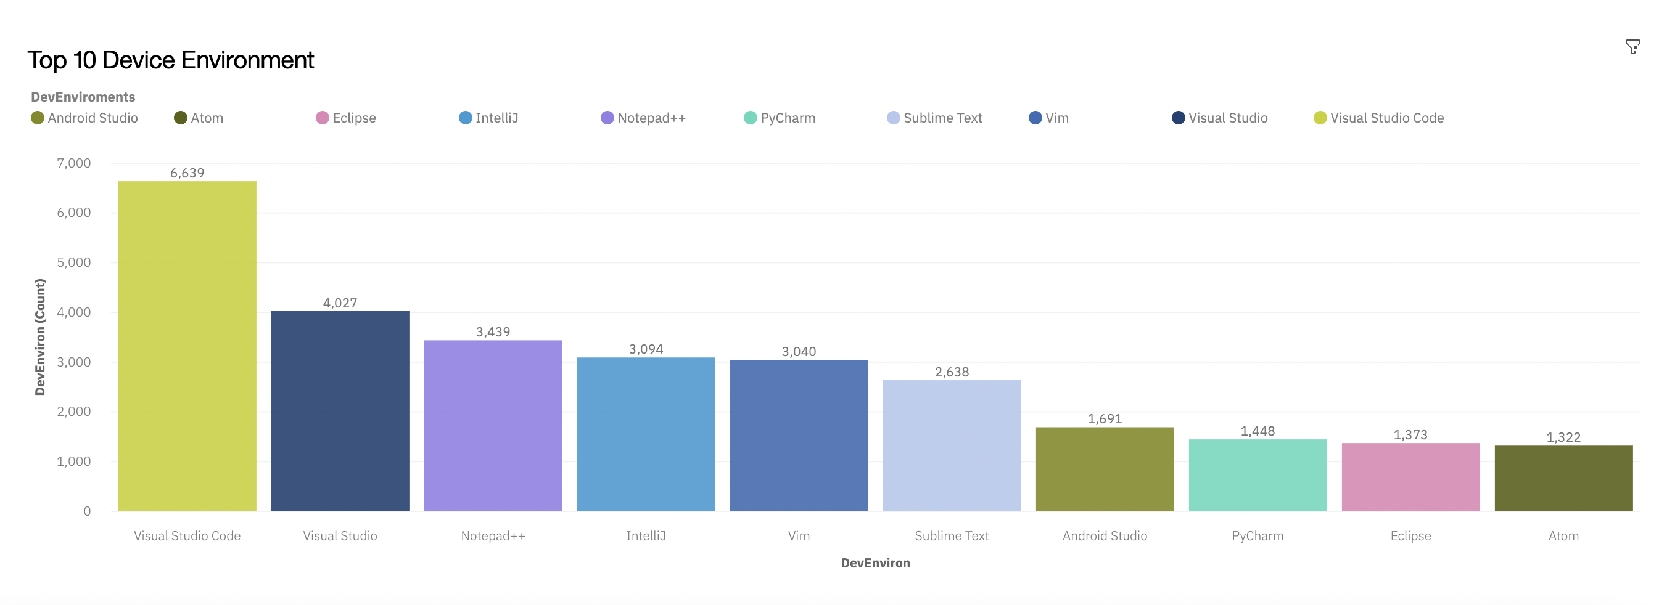
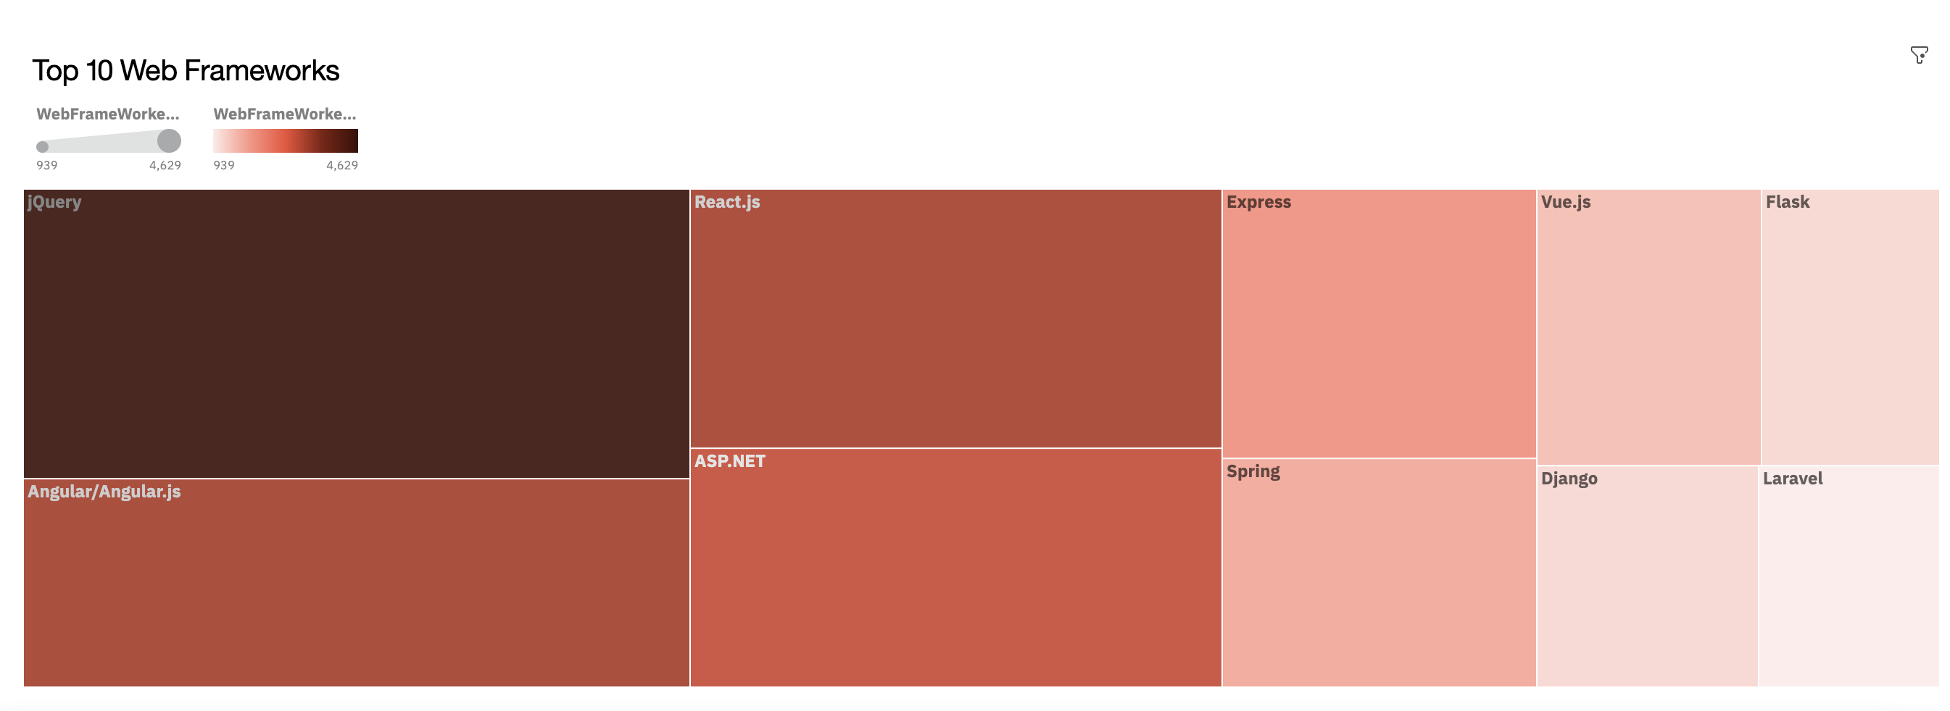
RESULTS

Slide 7
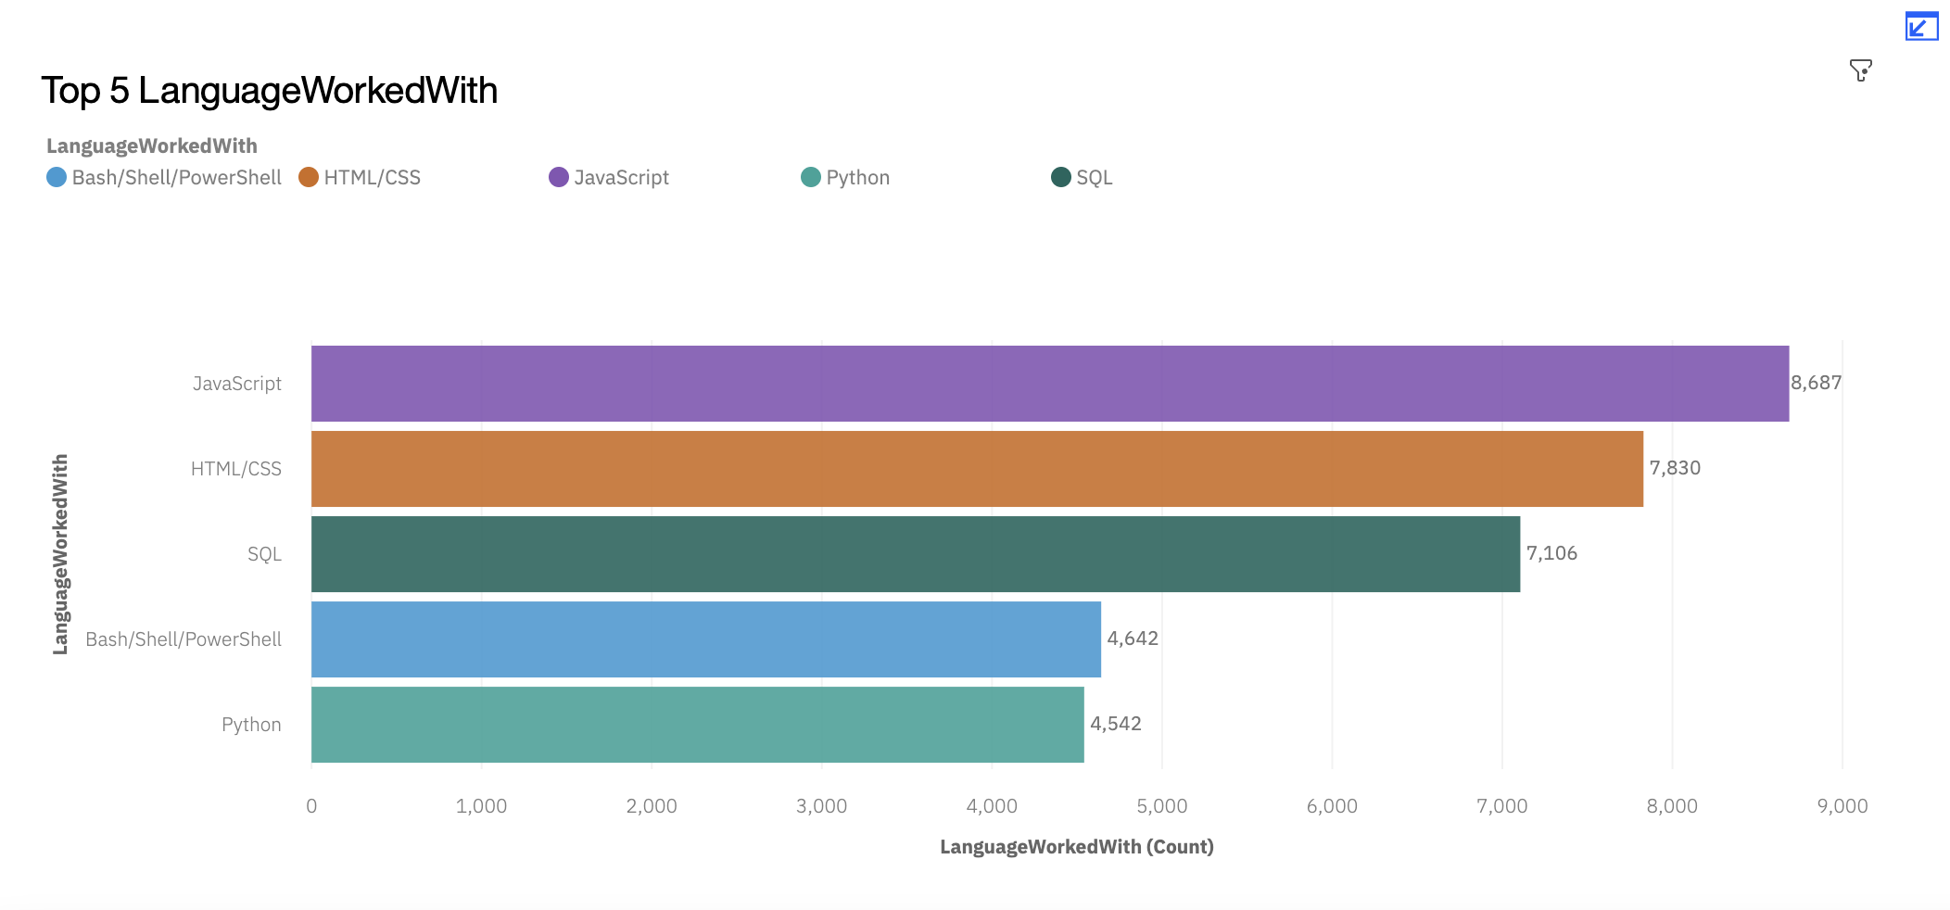

PROGRAMMING LANGUAGE TRENDS
Current Year
Next Year
<Bar chart of top 5 programming languages for the current year goes here.>
< Bar chart of top 5 programming languages for the next year goes here.>

Slide 8
PROGRAMMING LANGUAGE TRENDS - FINDINGS & IMPLICATIONS
Findings
JavaScript is the most popular
HTML/CSS will continue to be the second most popular
Python will rise and be popular next year
Implications
JavaScript continues to be the most popular next year
Bash is on decline and will be replace by TypeScript
SQL will stay in popularity

Slide 9
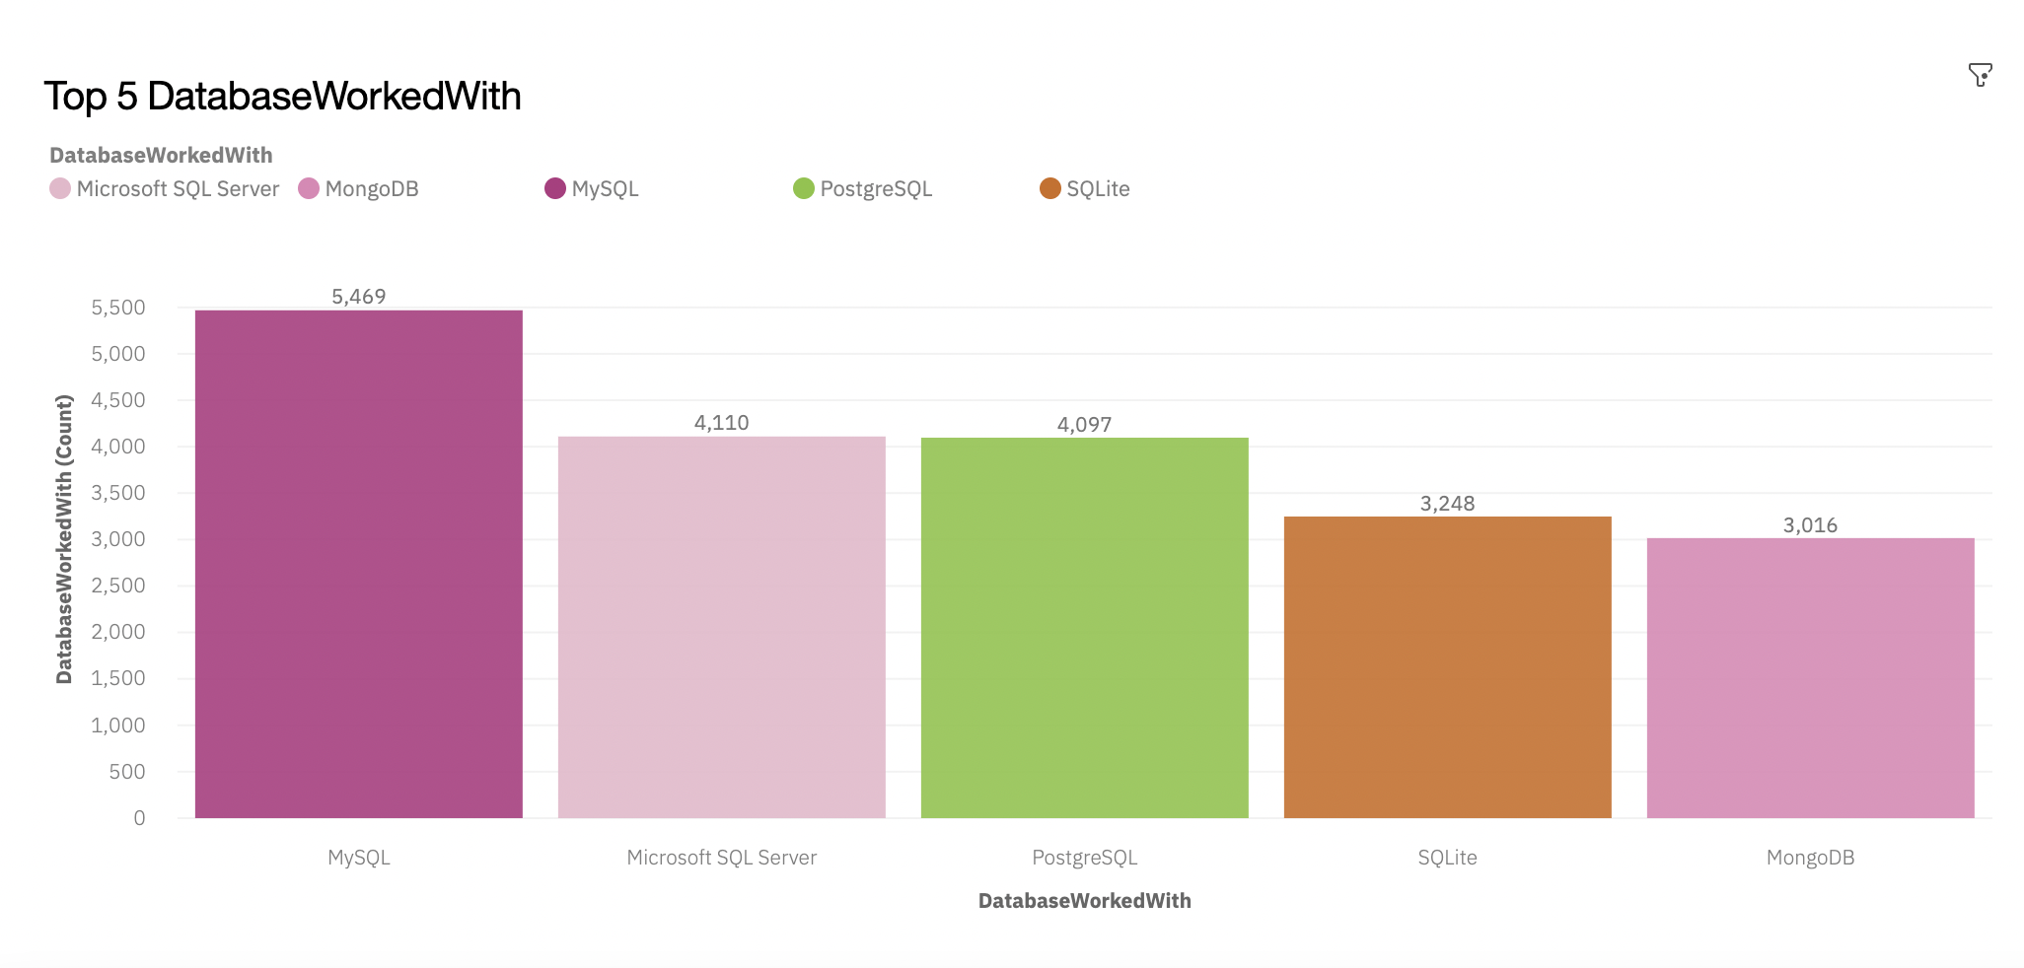
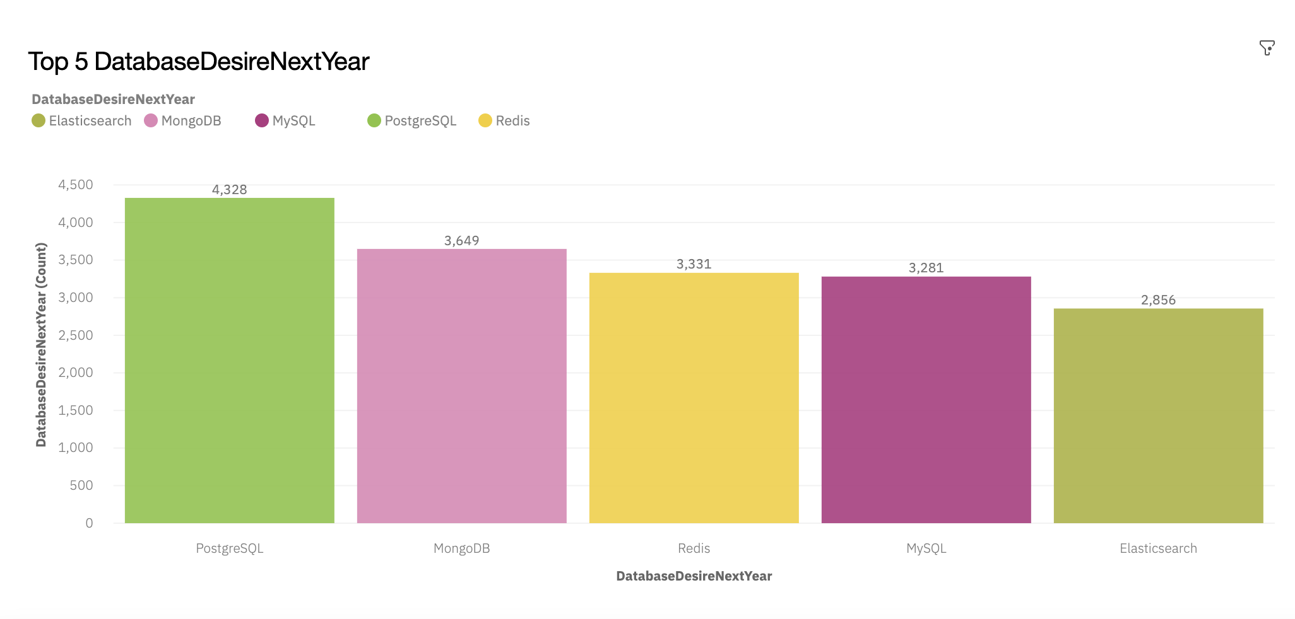
DATABASE TRENDS
Current Year
Next Year
< Bar chart of top 5 databases for the current year goes here >
< Bar chart of top 5 databases for the next year goes here.>

Slide 10
DATABASE TRENDS - FINDINGS & IMPLICATIONS
Findings
MySQL is currently the most popular
MongoDB is rapidly growing
Redis and Elasticsearch will emerge next year
Implications
MySQL is on declined and will be replaced by PostgreSQL
Database sector changes rapidly
New databases will emerge

Slide 11

DASHBOARD
https://dataplatform.cloud.ibm.com/dashboards/1bfd6038-ea89-4901-b6db-d2fb9a407505/view/7414a03704b26ffc63c8eee407ca79537835770eb3bbd60089d37b4959692497f06f4592c87c4c5b88475131a5bd140ac0

Slide 12
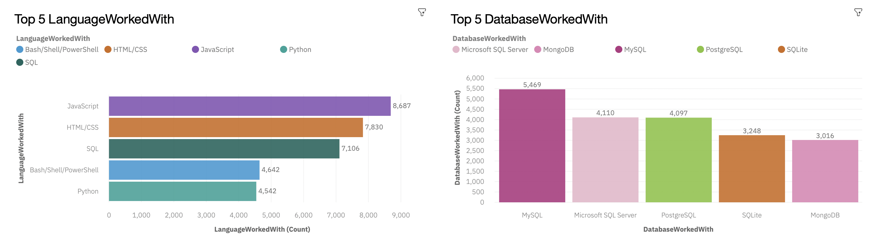
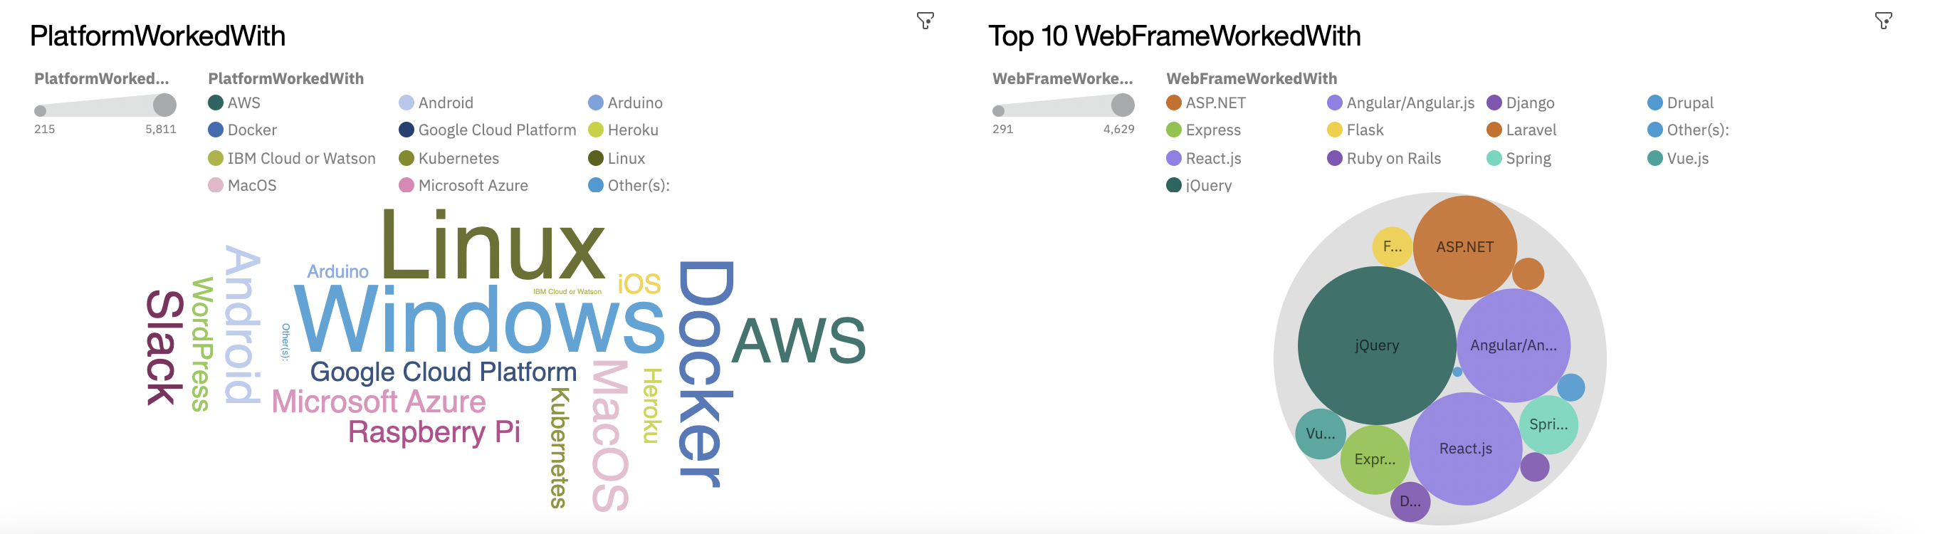
DASHBOARD TAB 1
Screenshot of dashboard tab 1 goes here

Slide 13
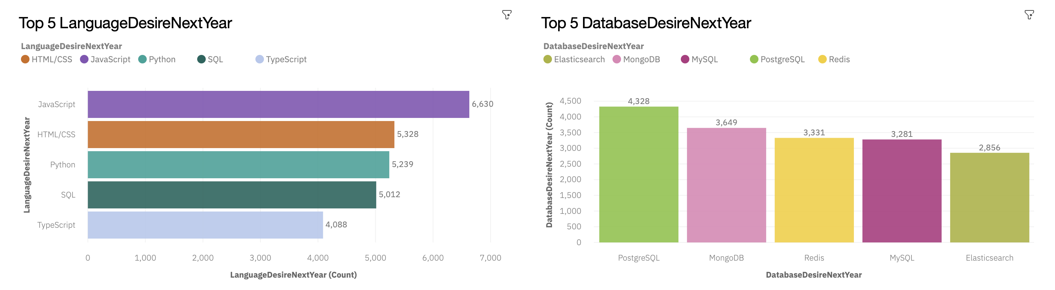
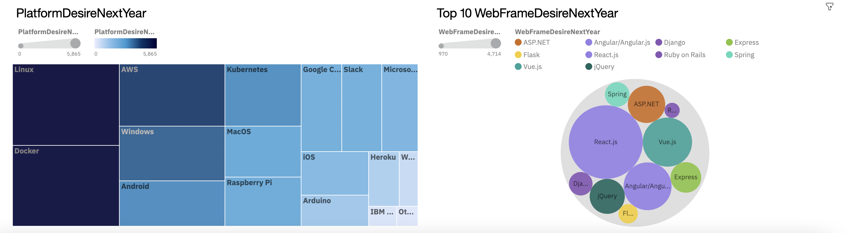
DASHBOARD TAB 2
Screenshot of dashboard tab 2 goes here

Slide 14
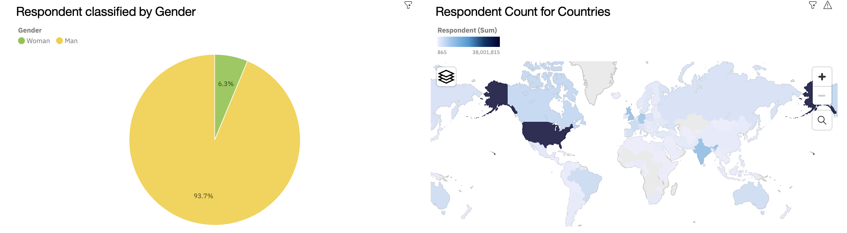
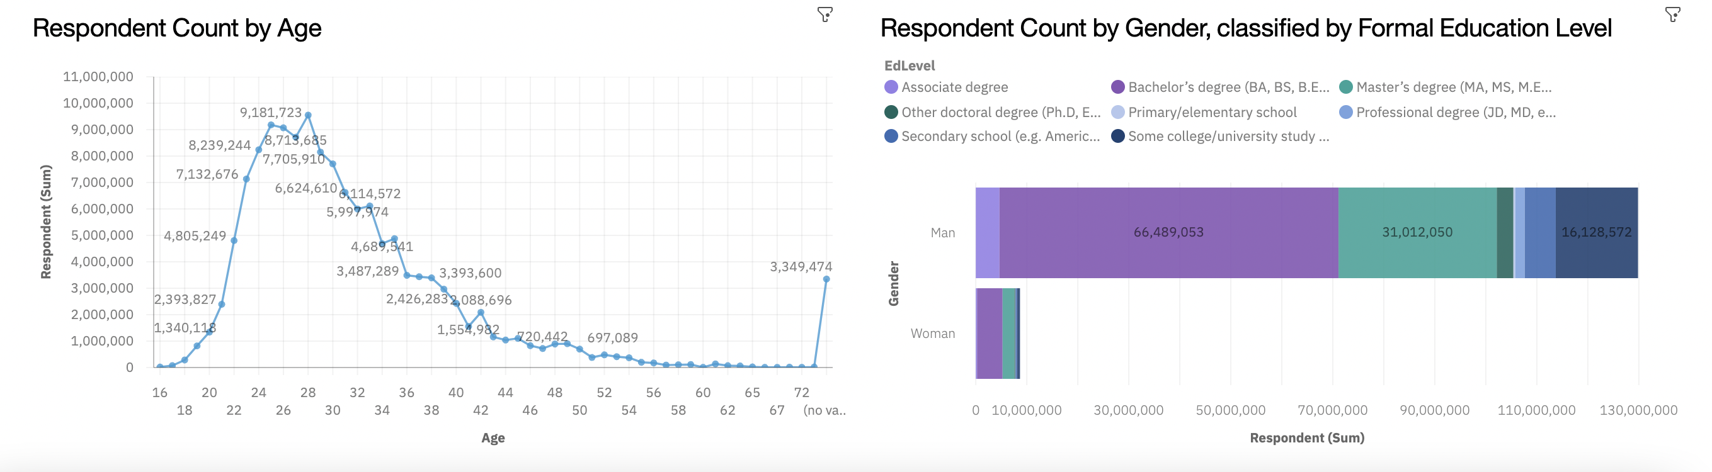
DASHBOARD TAB 3
Screenshot of dashboard tab 3 goes here

Slide 15
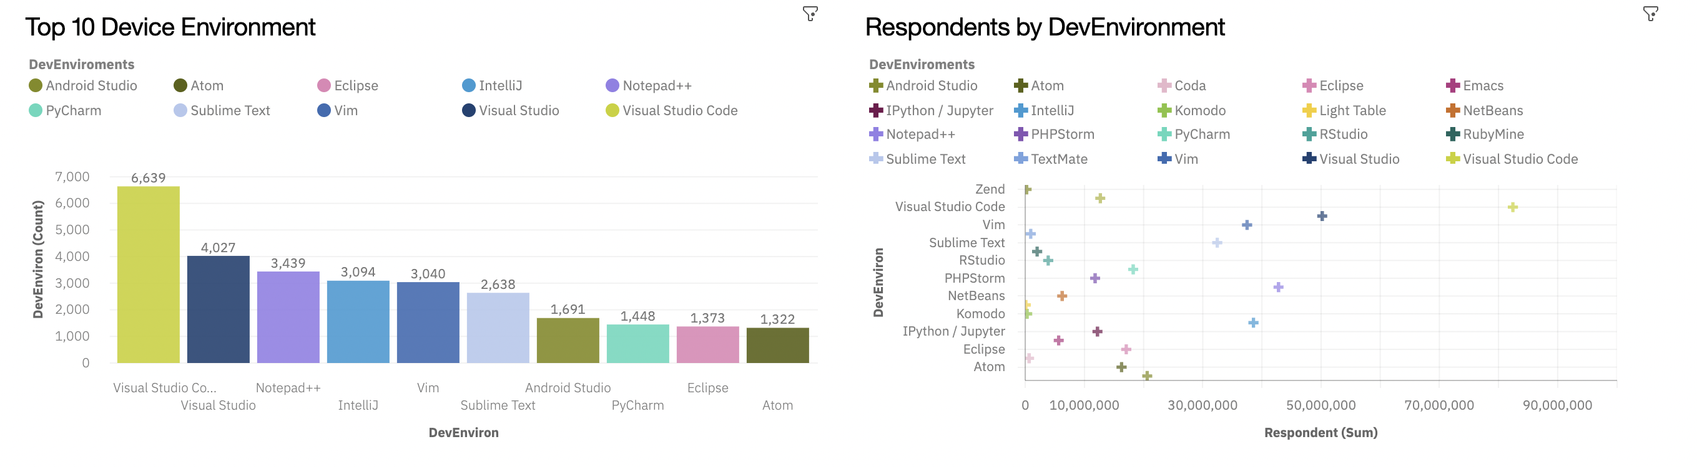
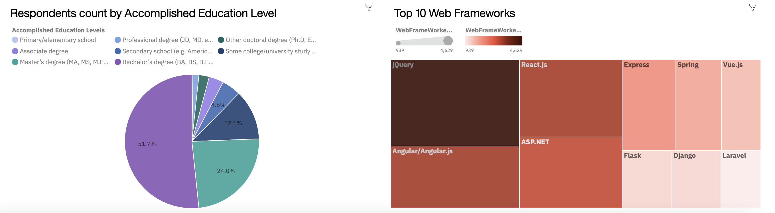
DASHBOARD TAB 4
Screenshot of dashboard tab 3 goes here

Slide 16
DISCUSSION
IBM Cloud for Data was used for data visualization
Data was cleaned, removed duplicates and empty values and was explored using the IBM Cloud Suites
Dataset provided were in .csv file format

Slide 17
OVERALL FINDINGS & IMPLICATIONS
Findings
Majority of respondents have Bachelor's Degree as their level of education
Most of the respondents were from United States
Linux will continue to reign the most popular platform
Implications
Development Environment have low positive correlation with the respondents due to rapid technological innovations
Python is rapidly emerging to be the most popular
Age of respondents was 28 years old

Slide 18

CONCLUSION
JavaScript will retain to be the most popular programming language until the future
Curiosity with regards to technology will continuously attract younger age
PostgreSQL will emerge as the most popular database and will replace MySQL
Technology rapidly develops for most of the advancements, efficiency and ease of use.

Slide 19

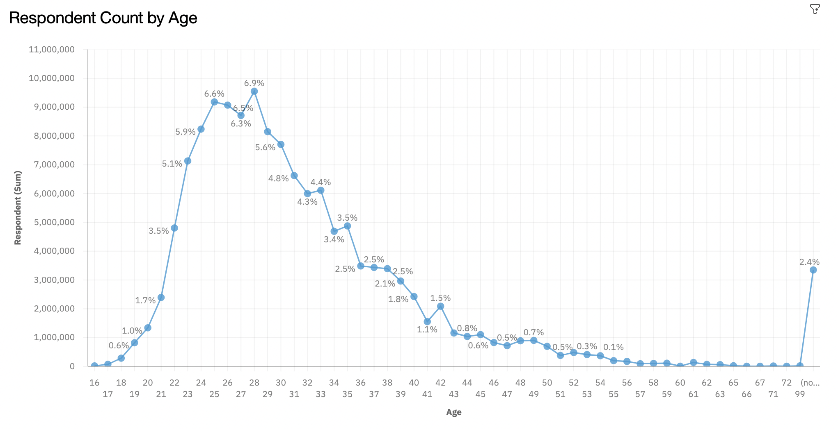
APPENDIX
Include any relevant additional charts, or tables that you may have created during the analysis phase.

Slide 20
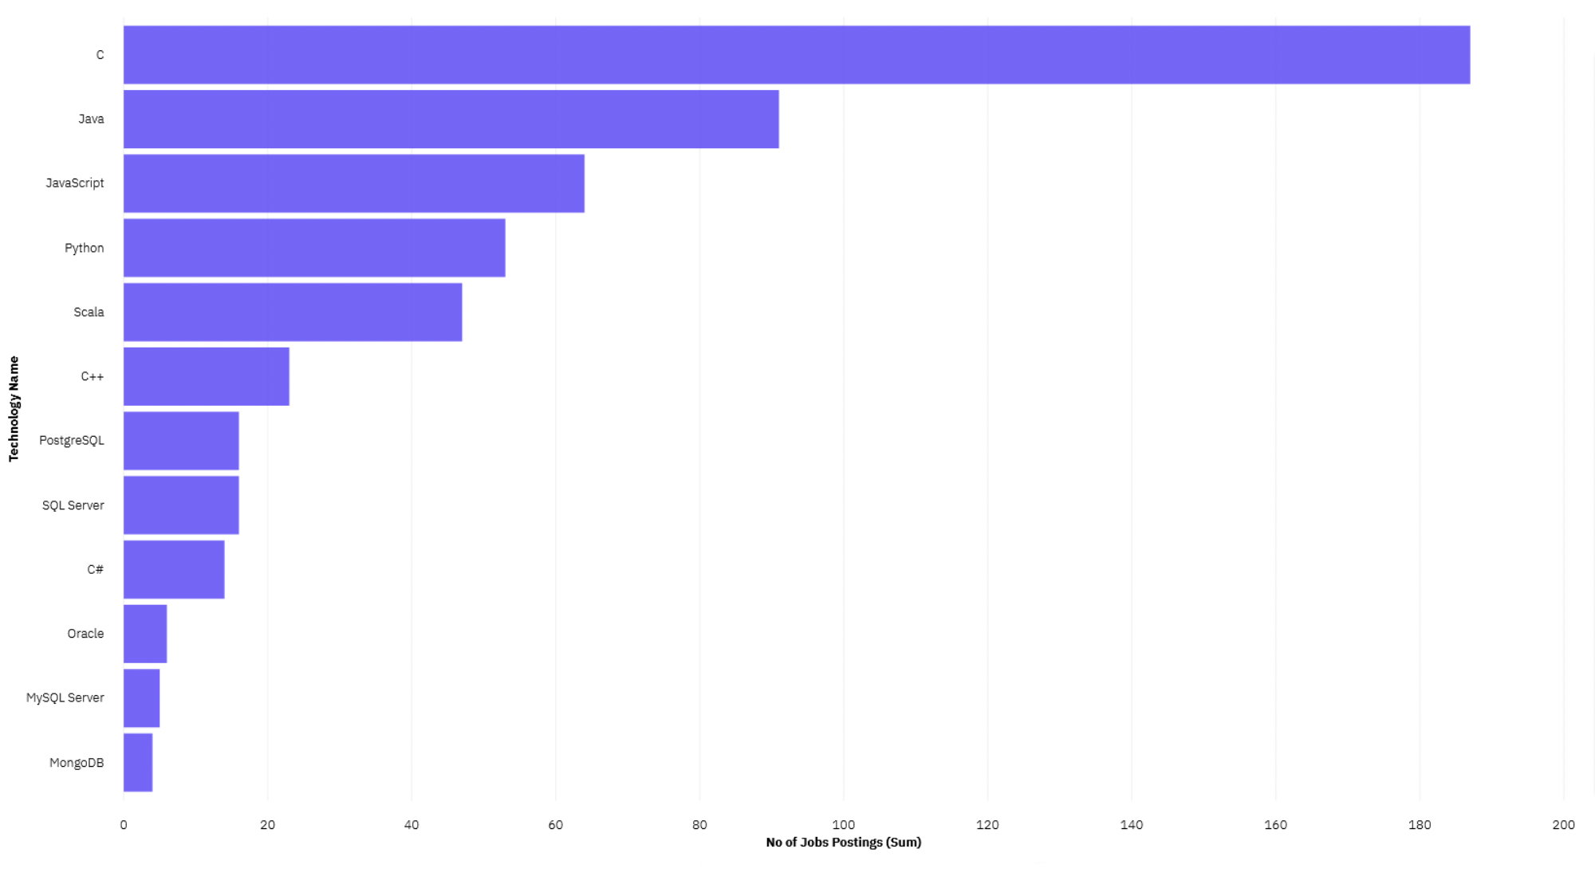
GITHUB JOB POSTINGS
In Module 1 you have collected the job postings data using GitHub API in a file named “github-job-postings.xlsx”. Present that data using a bar chart here. Order the bar chart in the descending order of number of job postings.

Slide 21
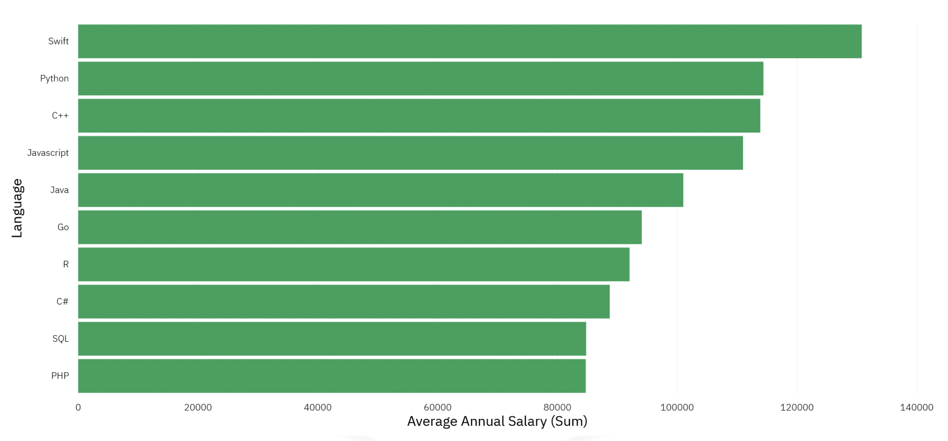
POPULAR LANGUAGES
In Module 1 you have collected the job postings data using web scraping in a file named “popular-languages.csv”. Present that data using a bar chart here. Order the bar chart in the descending order of salary.

Slide 22
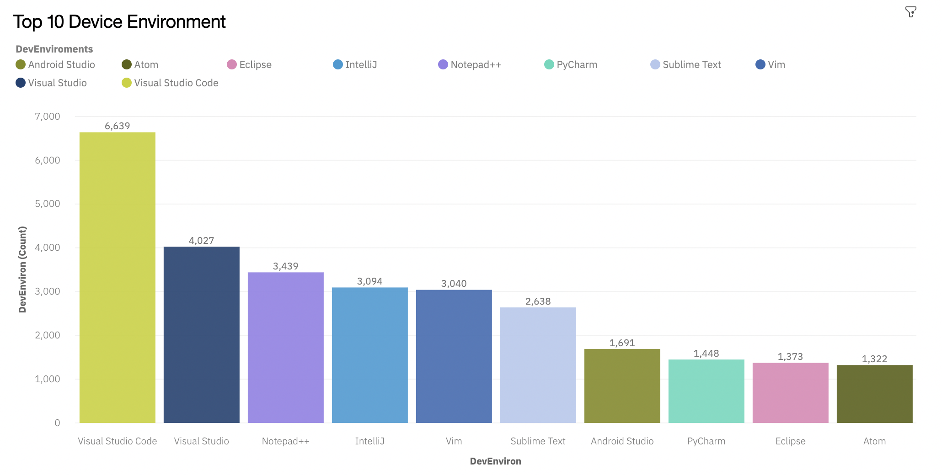
TOP 10 DEVICE ENVIRONMENT
In Module 1 you have collected the job postings data using web scraping in a file named “popular-languages.csv”. Present that data using a bar chart here. Order the bar chart in the descending order of salary.

Slide 23
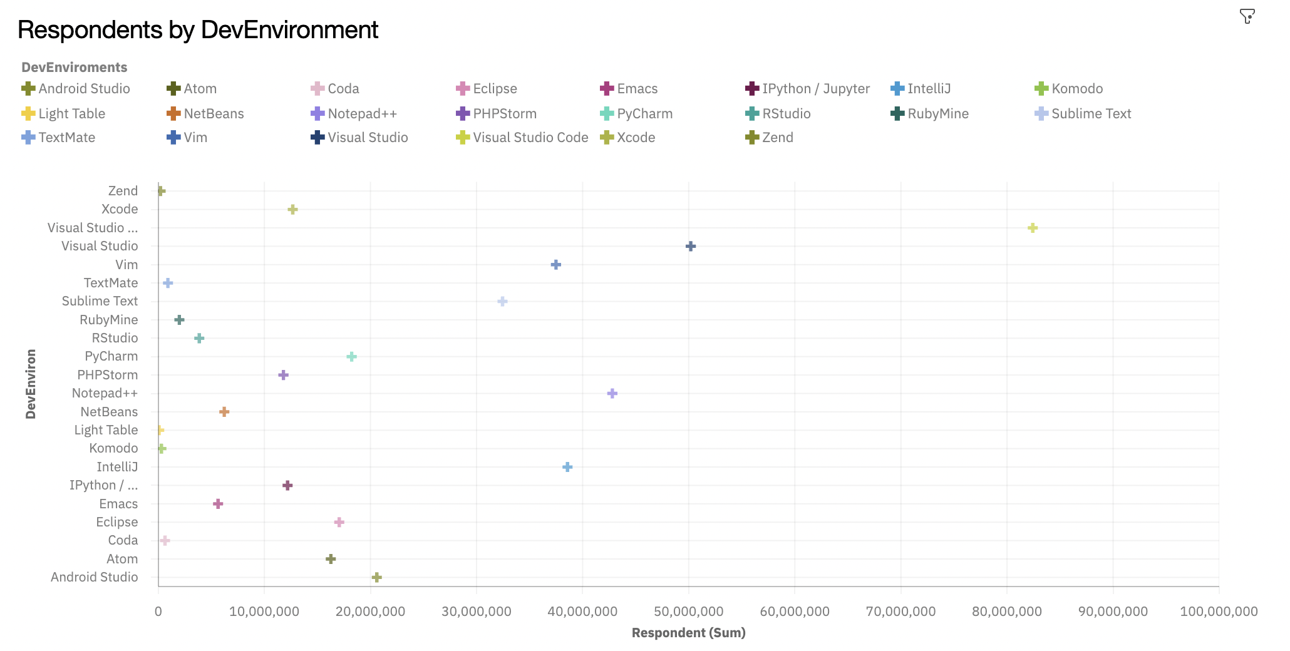
CORRELATION BETWEEN RESPONDENTS AND DEVENVIRONMENT
In Module 1 you have collected the job postings data using web scraping in a file named “popular-languages.csv”. Present that data using a bar chart here. Order the bar chart in the descending order of salary.

